Slide 1
Low Concentration Thin Films with Solar Tracking
Group 11
Amanda Klein
Jesse Trawick
Sean Murphy
Motiur Bhuiyan
Sponsors
Progress Energy

Slide 2
Goals and Objectives
To increase the efficiency of thin film solar panels using solar tracking and optical manipulation.
To create a limited space alternative to roof mounted arrays for individual residential applications.
Provide an interactive user interface for monitoring the power gained from running the array.

Slide 3
To meet these objectives…
The device must:
Occupy relatively low area.
Be self-sustaining; No outside power sources.
Low maintenance; Weatherproofed.
Affordable for residential consumers.

Slide 4
Specifications
Must operate in temperature range of 20ºF to 110ºF.
Must power a 300 watt load for 2 hours continuously.
Must not exceed 4ft x 4ft area.
Transmit data up to 50ft.
Display at least 1 months worth of data.

Slide 5
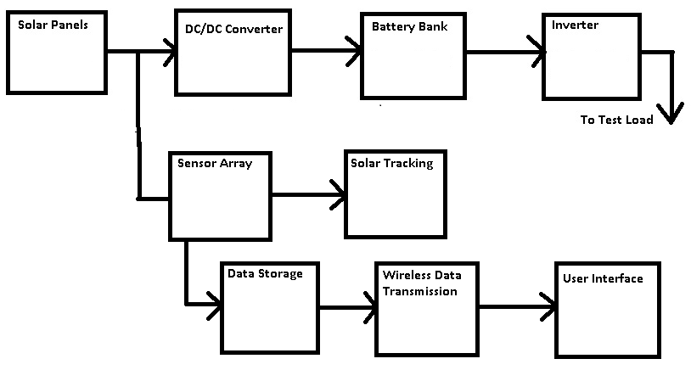
Project Block Diagram

Slide 6
Solar Panels, Tracking and Collection

Slide 7
Thin Film PV vs. Crystalline Silicon PV
Crystalline
Proven Technology
Costly to manufacture
Wafers are thick and bulky
15-20% efficiency with a maximum of 30%
Thin Films
Superior performance in hot and cloudy climates
Utilize rare Earth elements.
Multiple surface options (thin modules)
6-11% efficiency with a maximum of 21%

Slide 8
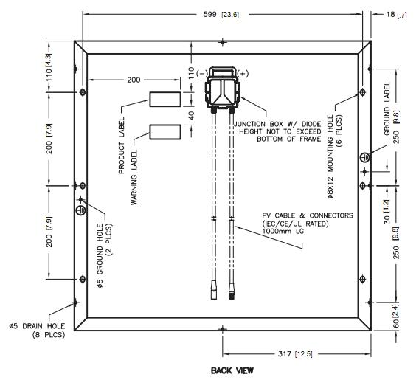
GSE 30W 12V Thin Film Solar Panel
Maximum power: 30W
Current at Operating Voltage: 1.7A
Operating Voltage: 17.5V
Temperature Coefficient for Power: -0.5% / °C
Temperature Coefficient for Voltage: -0.5% / °C
Cost $179.99

Slide 9
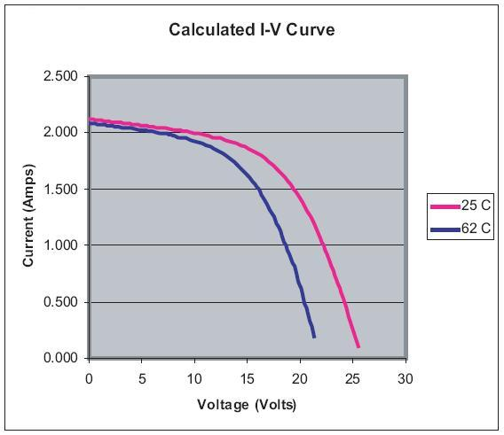
GSE 30W 12V Thin Film Solar Panel
High power output at higher temperatures.
At 77°F, power output is 30.63W, versus 26.25W at 144°F.
I-V Curve for GSE Solar 30W Thin Film Solar Panel

Slide 10
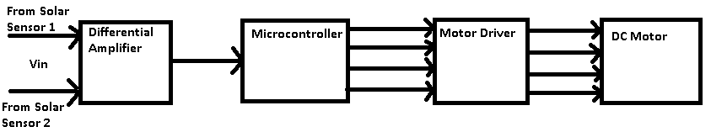
Solar Tracking Motor and Sensors
A differential amplifier (AD620) was chosen to help clean up the signal of each photoresistor and amplify the difference voltage that goes into the microcontroller.
Microcontroller (PIC18F) chosen since I have some in stock and codes with C.
Motor will be chosen on ability to rotate roughly 30lbs.

Slide 11
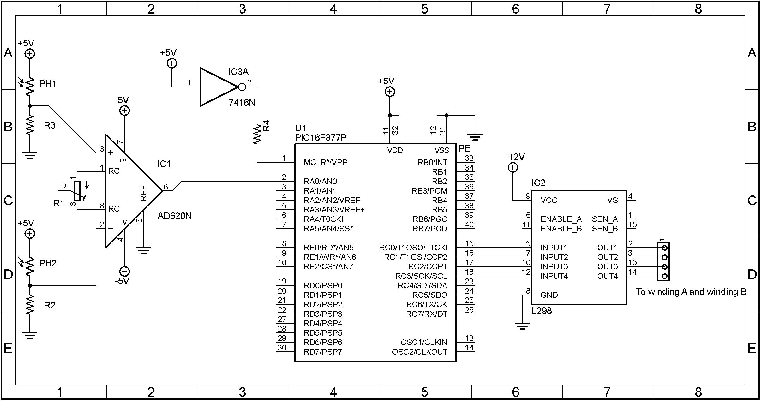
Solar Tracker Schematic

Slide 12
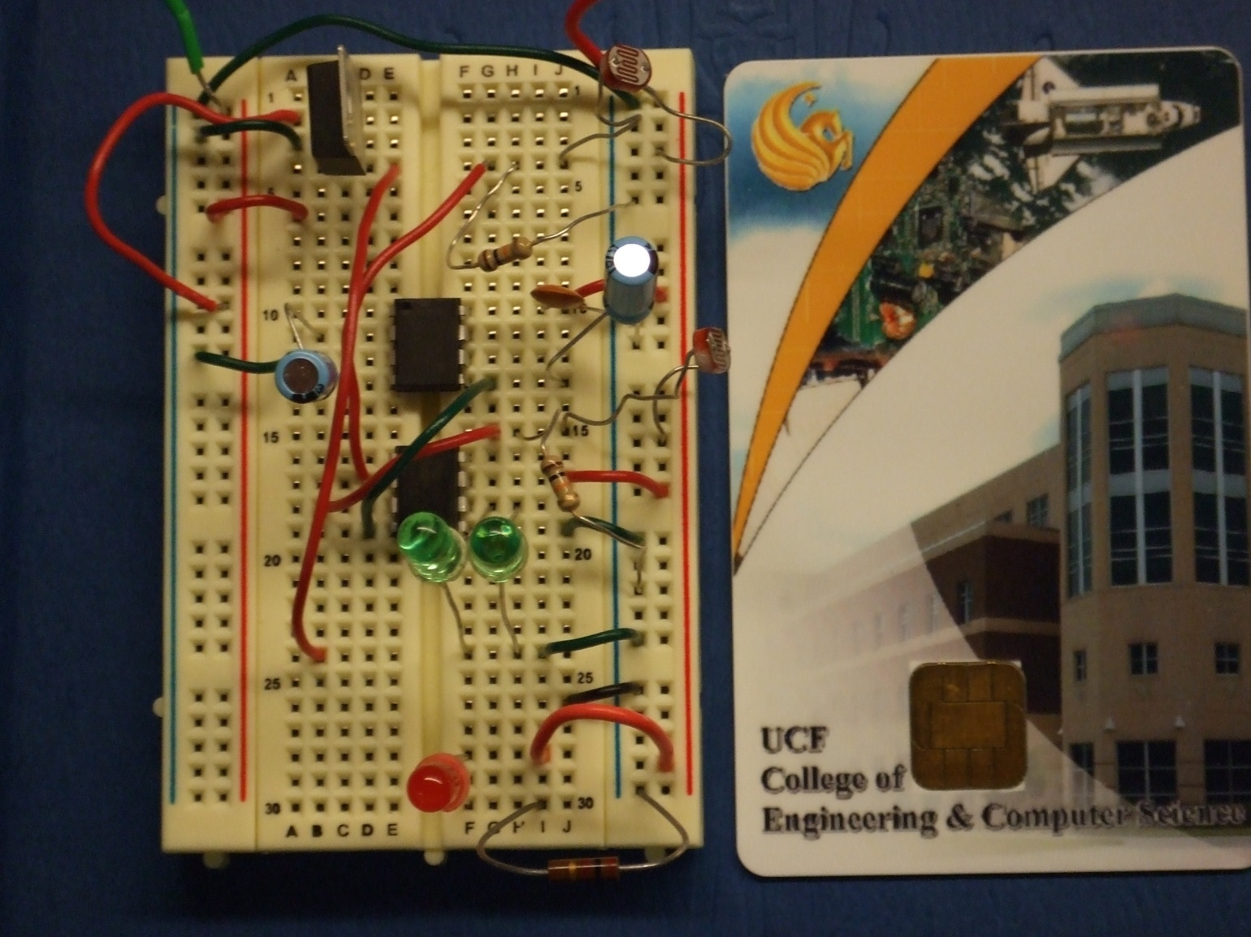
Test Solar Tracker

Slide 13
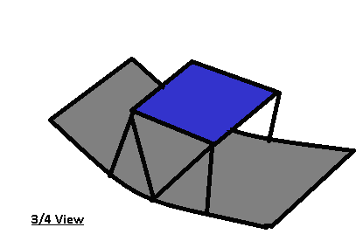
Solar Collector
Trough Design – Simplest and cheapest to implement.
If trough is twice the area of the panels, exposure breaks even.
Plastic paneling support with highly reflective Mylar covering.
Panels oriented back to back. This will test gain with and without solar collection at the same time.

Slide 14
DC/DC Converter

Slide 15
DC/DC Converter Goals and Specifications
Must provide protection from overcharging and back current into the panels.
Converts a 35V input to a 24V output.
Main lines must operate at around 2A while in full operation.
Must transmit >90% of power from panels to batteries.

Slide 16
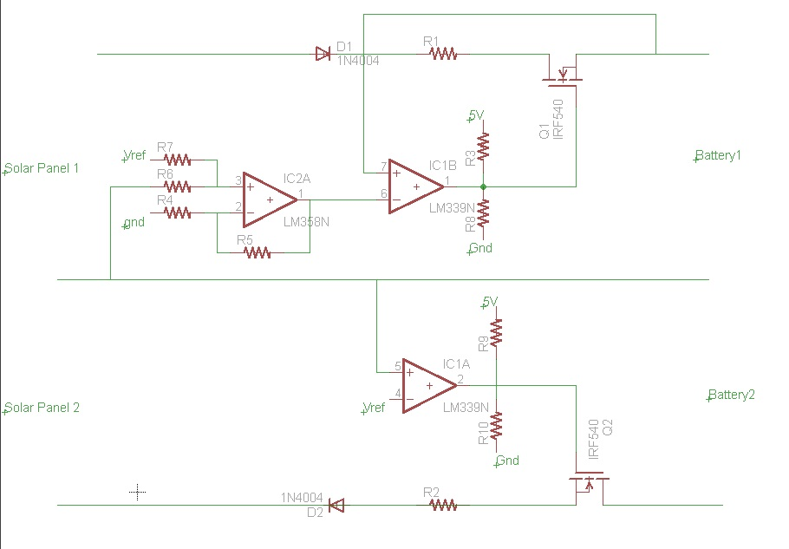
DC/DC Converter Schematic

Slide 17
Components Used in DC/DC Converter
MAX323 SPST Analog Switch: Currently have MAX324, which works, but has the wrong polarity.
LM139 Quad Comparator: +/- 36V power supply, Output TTL Compatible
LM393 Operational Amplifier: Leftover from Electronics 2, in process of testing to see if additional op-amp needed.

Slide 18
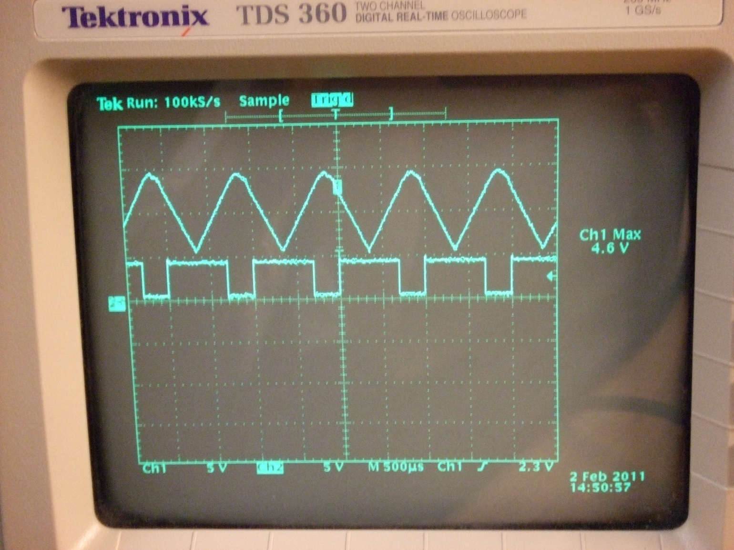
Testing the Logic

Slide 19
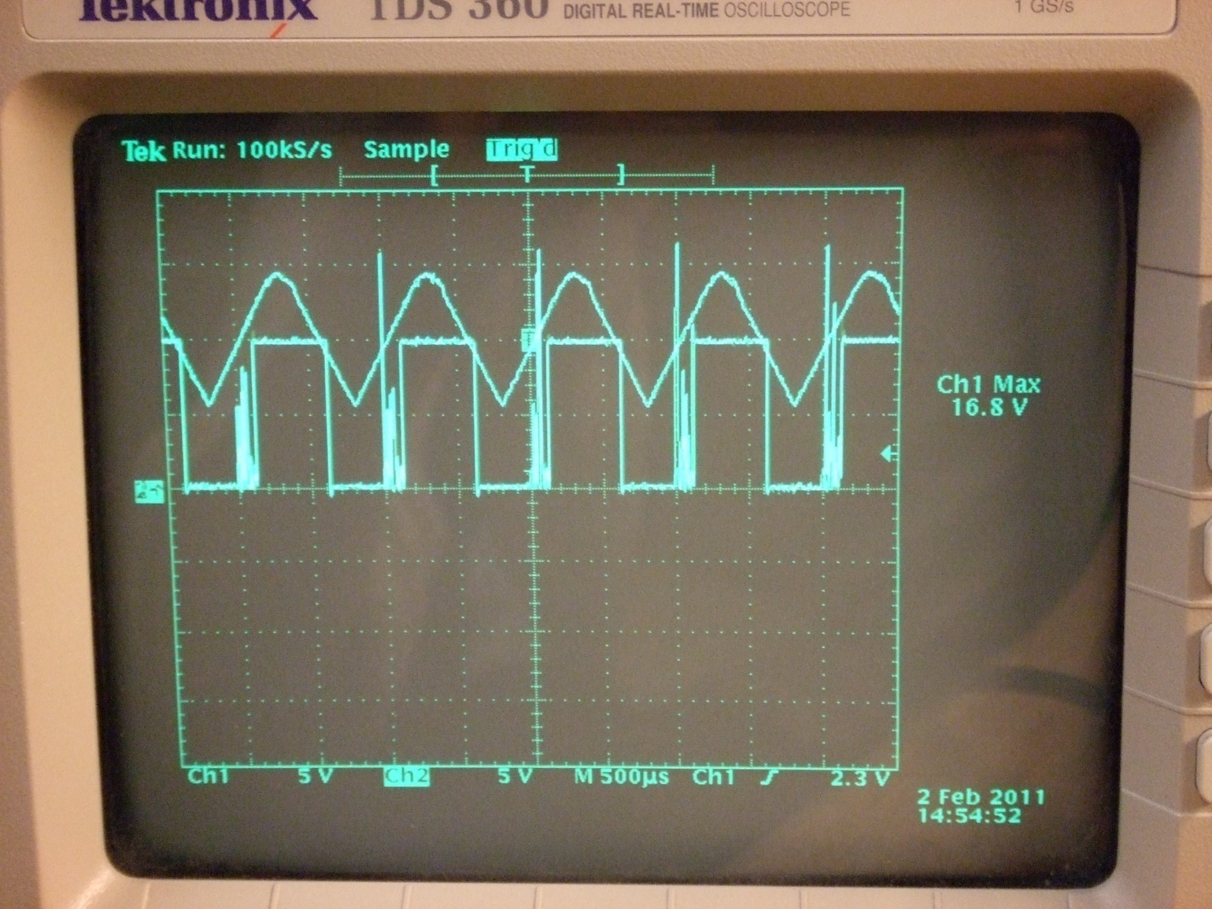
Testing the Switching

Slide 20
Power Systems

Slide 21
Power Systems Goals and Specifications
Provide power for all integrated circuits.
Convert power from DC/DC Converter to US standard AC for use on load.
Supply voltages of +16V and +5V DC to integrated circuits.
24V battery/inverter system to supply 300W to test load.
>90% Efficiency
Runs load for 2 hours continuously.

Slide 22
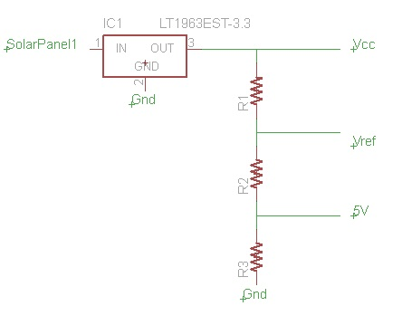
Power Supply Schematic
LT3012 Adjustable Linear Regulator: 4V to 80V input, 1.24V to 60V output.
Vcc powers DC/DC Converter chips.
Vref used for logic.
+5V made available to other boards.

Slide 23
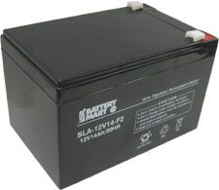
Battery Bank
SLA-12V14-F2
SLA Technology – Simple to charge, mature technology, weight not an issue
14AH Capacity
24V System (2 batteries)
For our specifications, capacity is roughly 13AH for a 24V system.

Slide 24
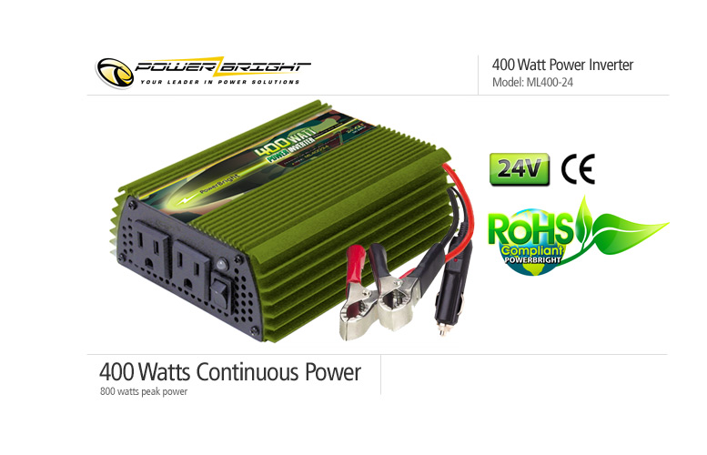
Inverter
Powerbright ML-400-24
24V Input
400W continuous: Meets requirement for 300W load
800W Peak
Low/High Voltage warnings and shutdown built-in
$39.99

Slide 25
Data Collection and Storage

Slide 26
Panel V, I and T Sensors
AD8276 Difference Amplifier – 2V to 36V supply, built-in resistance matching, input range roughly 3x supply.
ACS714 Hall Effect Current Sensor – 5V Supply, 1.5% error, 2.5V output, No effect on power loop.
DS1822 Temperature Sensor – Range of -10ºC to 150ºC, ±2ºC error, can operate in parasitic power mode.

Slide 27
Data Storage
Purpose: store current, voltage, temperature data from sensor
Must gather data every hour during functional time period
Must store a total of one month's worth of data for statistical analysis
Must have wireless capabilities to allow wireless transmission of data to a user interface.

Slide 28
PIC32MX795F512L Kit Comparison
Starter Kit | Flash Program Memory | RAM | Speed | Cache | Power Supply | USB Ports | Ethernet Ports
PIC32 General Purpose Starter Kit | 512KB | 32KB | 80MHz | 256 Byte | 3.3V | No | No
PIC32 USB Starter Kit II | 512 KB | 128KB | 80MHz | 256 Byte | 3.3V | Yes | No
PIC32 Ethernet Starter Kit | 512KB | 128KB | 80MHz | 256 Byte | 3.3V | Yes | Yes

Slide 29
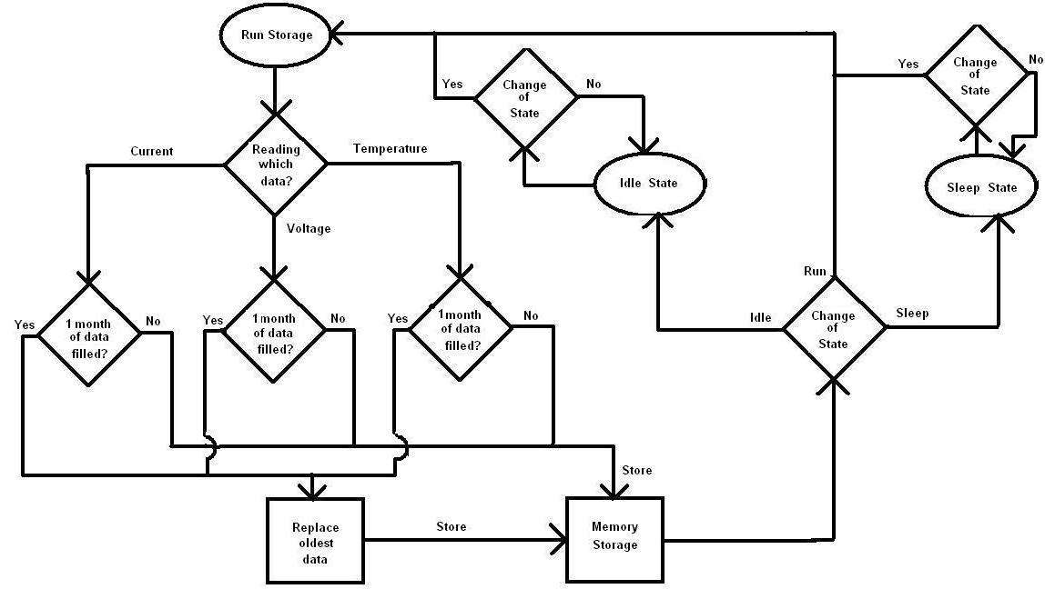
Data Storage Logical Flowchart

Slide 30
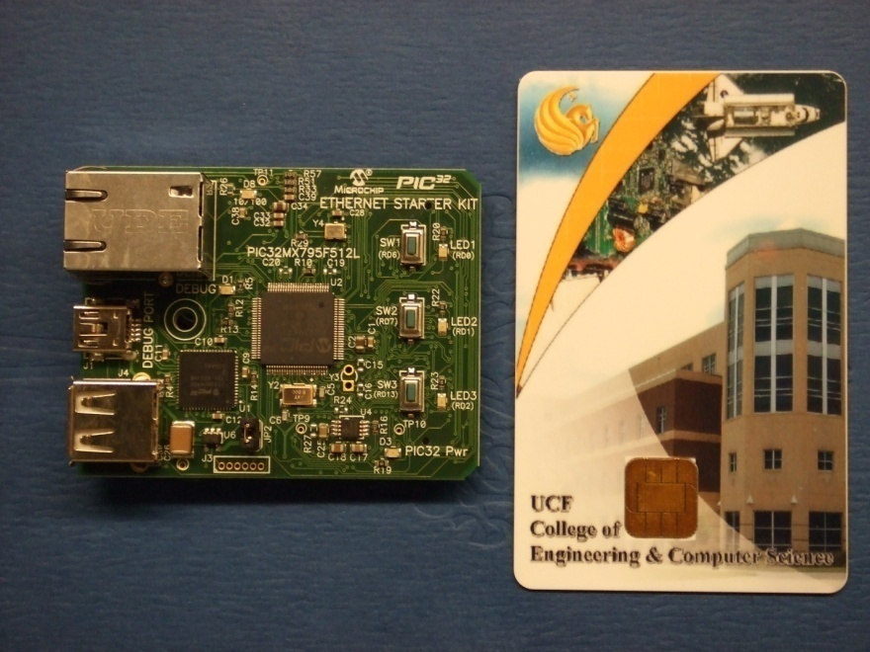
Data Storage Unit
LED lights and push buttons for state control
Windows compatibility
Programmable in assembly and C; compiler comes with the starter kit
Problems with design?

Slide 31
I/O Expansion Board
Pin connectivity is necessary for the sensor connections
To allow more access to outside connections, an I/O expansion board is needed.
Only one such expansion board could be used specifically with the PIC32 Ethernet Starter Kit: PIC32 I/O Expansion Board

Slide 32
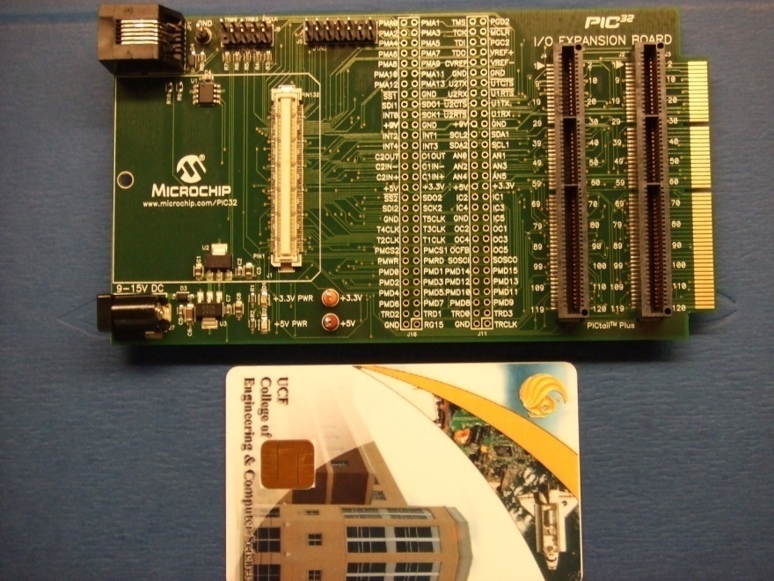
I/O Expansion Board
Pins for input connections (MCU signals)
PICtail connector
Application code programmed in the data storage unit
Power supply

Slide 33
LCD Display
Purpose: testing of input data gathered from the sensors to the PIC32
Testing the accuracy of the wireless transmission to the user interface.
Act as a mini user interface, for extra insurance.
The program running the data storage will be responsible for the LCD displayed information, in the format: V = xxV I = xxA T = xxF P = xxW

Slide 34
LCD Displays
LCD Module | Screen Size | Character Line Sizes | Character Size | Power Supply | Prices
Yellow-Green | 64.5 x 16.4 mm | 8 x 1 | 3 x 5.23mm | +5V | $10
Arduino | 30.4 x 14mm | 16 x 2 | 2.95 x 4.15mm | +5V | $11
Alphanumeric | 61 x 15.8mm | 16 x 2 | 2.96 x 5.56mm | +5V | $21
Blue Backlight/White HD44780 | 64.5 x 13.8mm | 16 x 2 | 3 x 5.02mm | +3.3V | $7
Blue Backlight/White HD44780 | 76 x 26mm | 20 x 4 | 2.94 x 4.74mm | +5V | $8

Slide 35
Data Transmission and User Interface

Slide 36
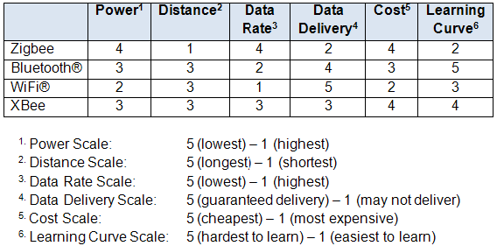
Wireless Transmission Comparison
1. Power Scale: 5 (lowest) – 1 (highest)
2. Distance Scale: 5 (longest) – 1 (shortest)
3. Data Rate Scale: 5 (lowest) – 1 (highest)
4. Data Delivery Scale: 5 (guaranteed delivery) – 1 (may not deliver)
5. Cost Scale: 5 (cheapest) – 1 (most expensive)
6. Learning Curve Scale: 5 (hardest to learn) – 1 (easiest to learn)

Slide 37
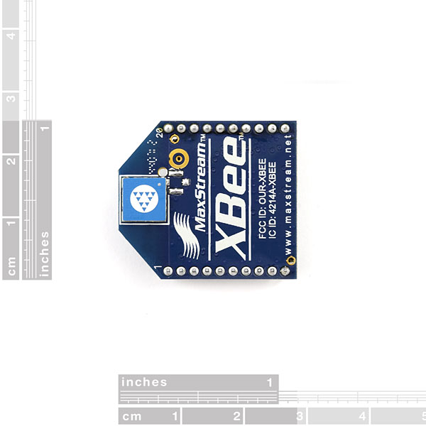
Xbee Chip Antenna
Features:
3.3V @ 50mA
250kbps Max data rate
1mW output (+0dBm)
300ft (100m) range
Built-in antenna
Fully FCC certified
6 10-bit ADC input pins
8 digital IO pins
128-bit encryption
Local or over-air configuration
AT or API command set

Slide 38
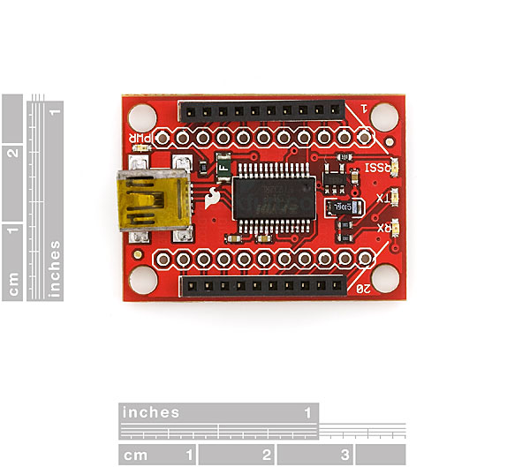
XBee Explorer USB
Features:
This is a easy to use, USB to serial base unit for the XBee line.
This unit works with all XBee modules (i.e. Series 1 and Series 2.5, standard and Pro version).

Slide 39
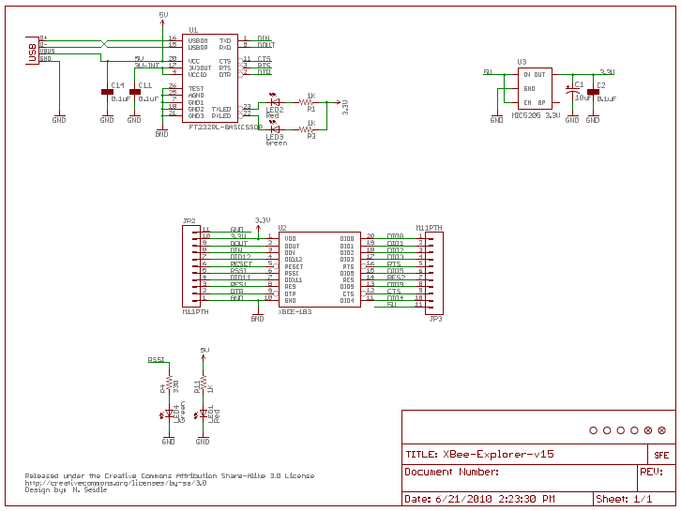
Schematic of XBee Explorer USB

Slide 40
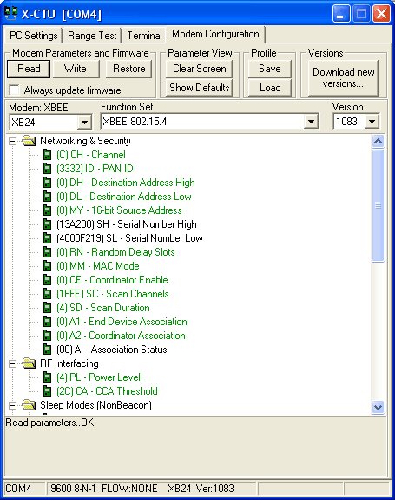
X-CTU Utility
The XBee module needs to be configured through the X-CTU utility for it to work with a PC or laptop.
The X-CTU operates only in Windows® platforms. It is not compatible with Windows® 95, Windows® NT, UNIX and Linux.

Slide 41
User Interface
A script will be written using Python (i.e. programming language) to store data onto a computer. However, to run a Python script
in a Windows® environment requires the Python packages.

Slide 42
General Architecture

Slide 43
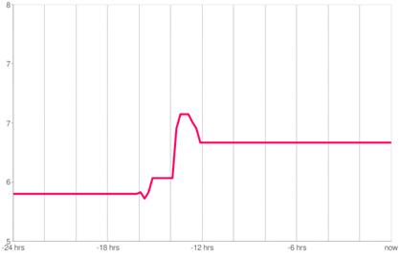
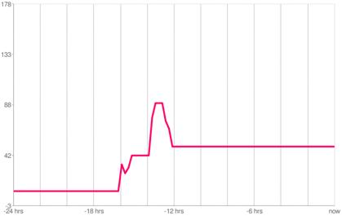
Graphs
Wireless PV panel voltage graph
Wireless PV panel current graph
Option1: PHP & MySQL (in PC/Laptop).
Option 2: Third Party API & online database service provider (in Web).

Slide 44
Budget and Project Status

Slide 45
Budget Breakdown
 | Budgeted | Spent | Expected | Comments
Solar Panels | $400 | $379 | $379
Solar Tracking | $150 | $15 | $30 | Motor and Controller salvaged; Need to buy limit switches
Solar Collector | $250 | $17 | $40 | Making from plastic & foil vs aluminum
DC/DC Converter | $75 | $16 | $25 | Need more Op-amps than projected
Battery Bank | $50 | $0 | $80 | Battery more expensve due to AH rating
Inverter | $50 | $55 | $55
I, V, and T Sensors | $20 | $0 | $20
Data Storage | $120 | $122 | $122
Wireless Xmission | $50 | $87 | $87 | Using Xbee instead of normal router
User Interface | $0 | $0 | $0 | Subject to change
Miscellaneous (PCB) | $100 | $0 | Unknown | PCB cost dependent on how many PCBs we end up with
Mounting | $70 | $48 | $80 | Bought cart, need plywood and aluminum rod/bar framing
 | $1,335 | $739 | $918

Slide 46
Completion Breakdown

Slide 47
To Do List
Solar Tracking
Mount motor and controller onto cart.
Implement limit switches.
Final functionality testing under load.
DC/DC Converter and Power Systems
Implement power circuit.
Test finalized converter design w/ batteries and panels.
Figure out PCB layouts.
Data Collection and Storage
Order sensors.
Program PIC and implement LCD.
Data Transmission and User Interface
Test X-Bee functionality with data storage.
Begin programming the data processing and user outputs.

